Slide 1



Project Reflection Video
CS372/Minjae Kyung
Notes:
Hello, I am Minjae Kyung. Today, I will present my reflection on Andoni Zalaya's presentation titled “Recognizing MNIST with Feedforward Neural Networks" from the CS372 final project presentations.

Slide 2
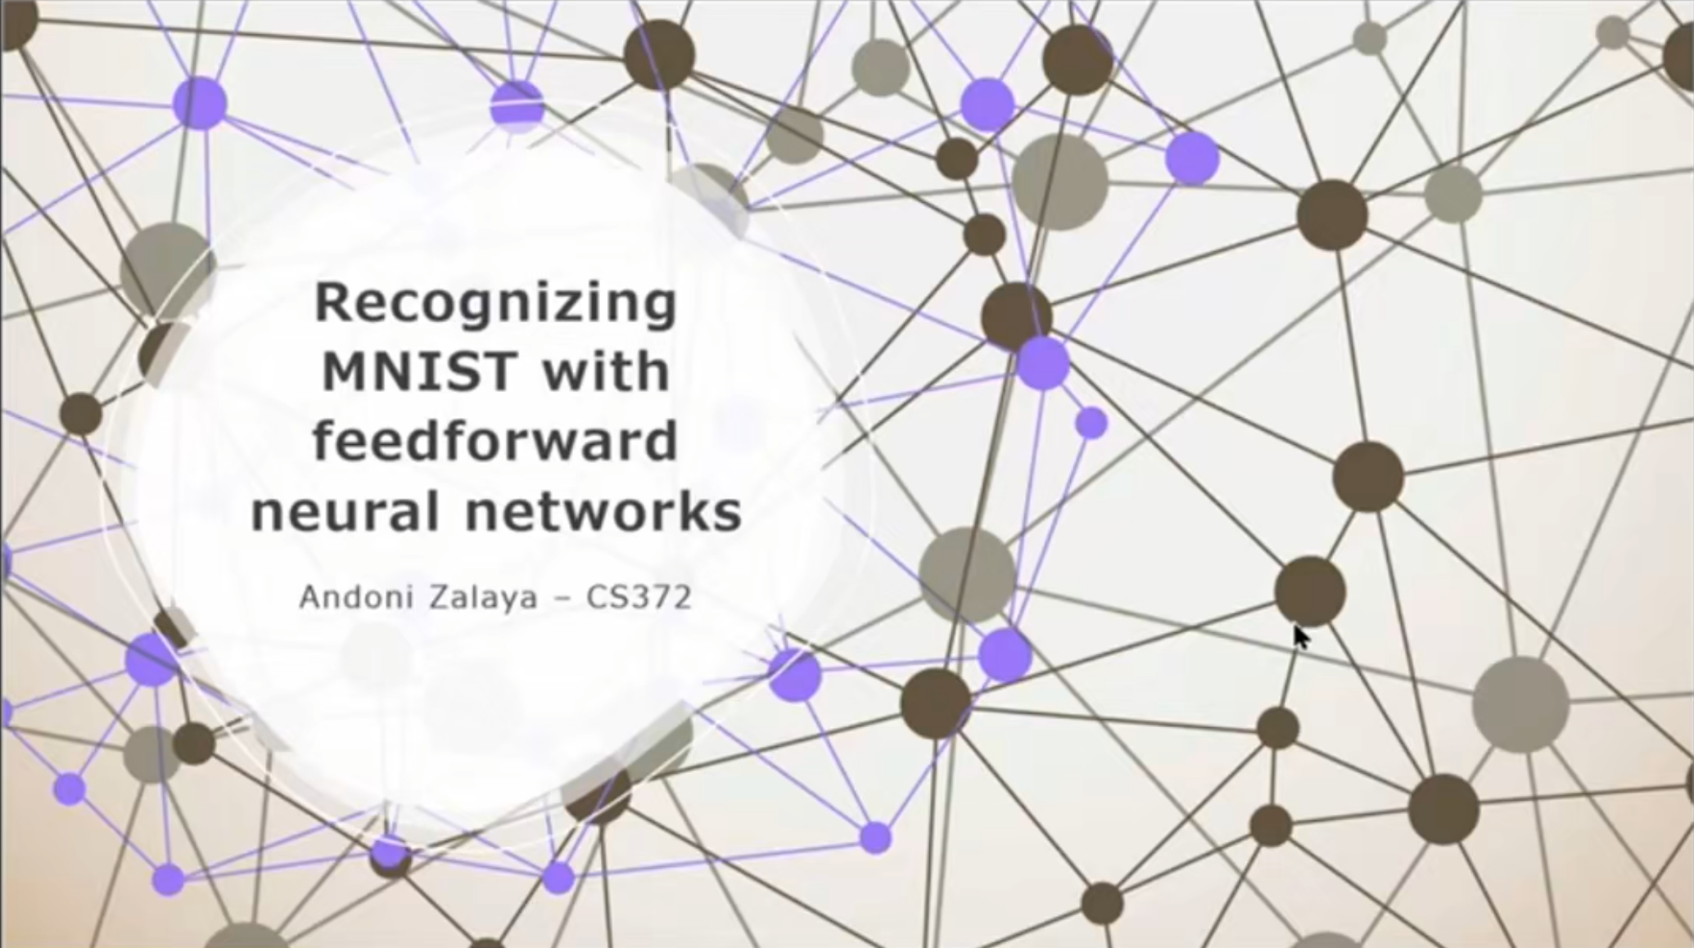
Notes:
The main reason I chose Andoni's presentation is that he used neural networks to build a prediction model like me. Although he dealt with an image classification problem and I addressed a different kind of problem—predicting movie revenue—I thought there would be much to learn from his approach and implementation process since we used the same core technology.

Slide 3
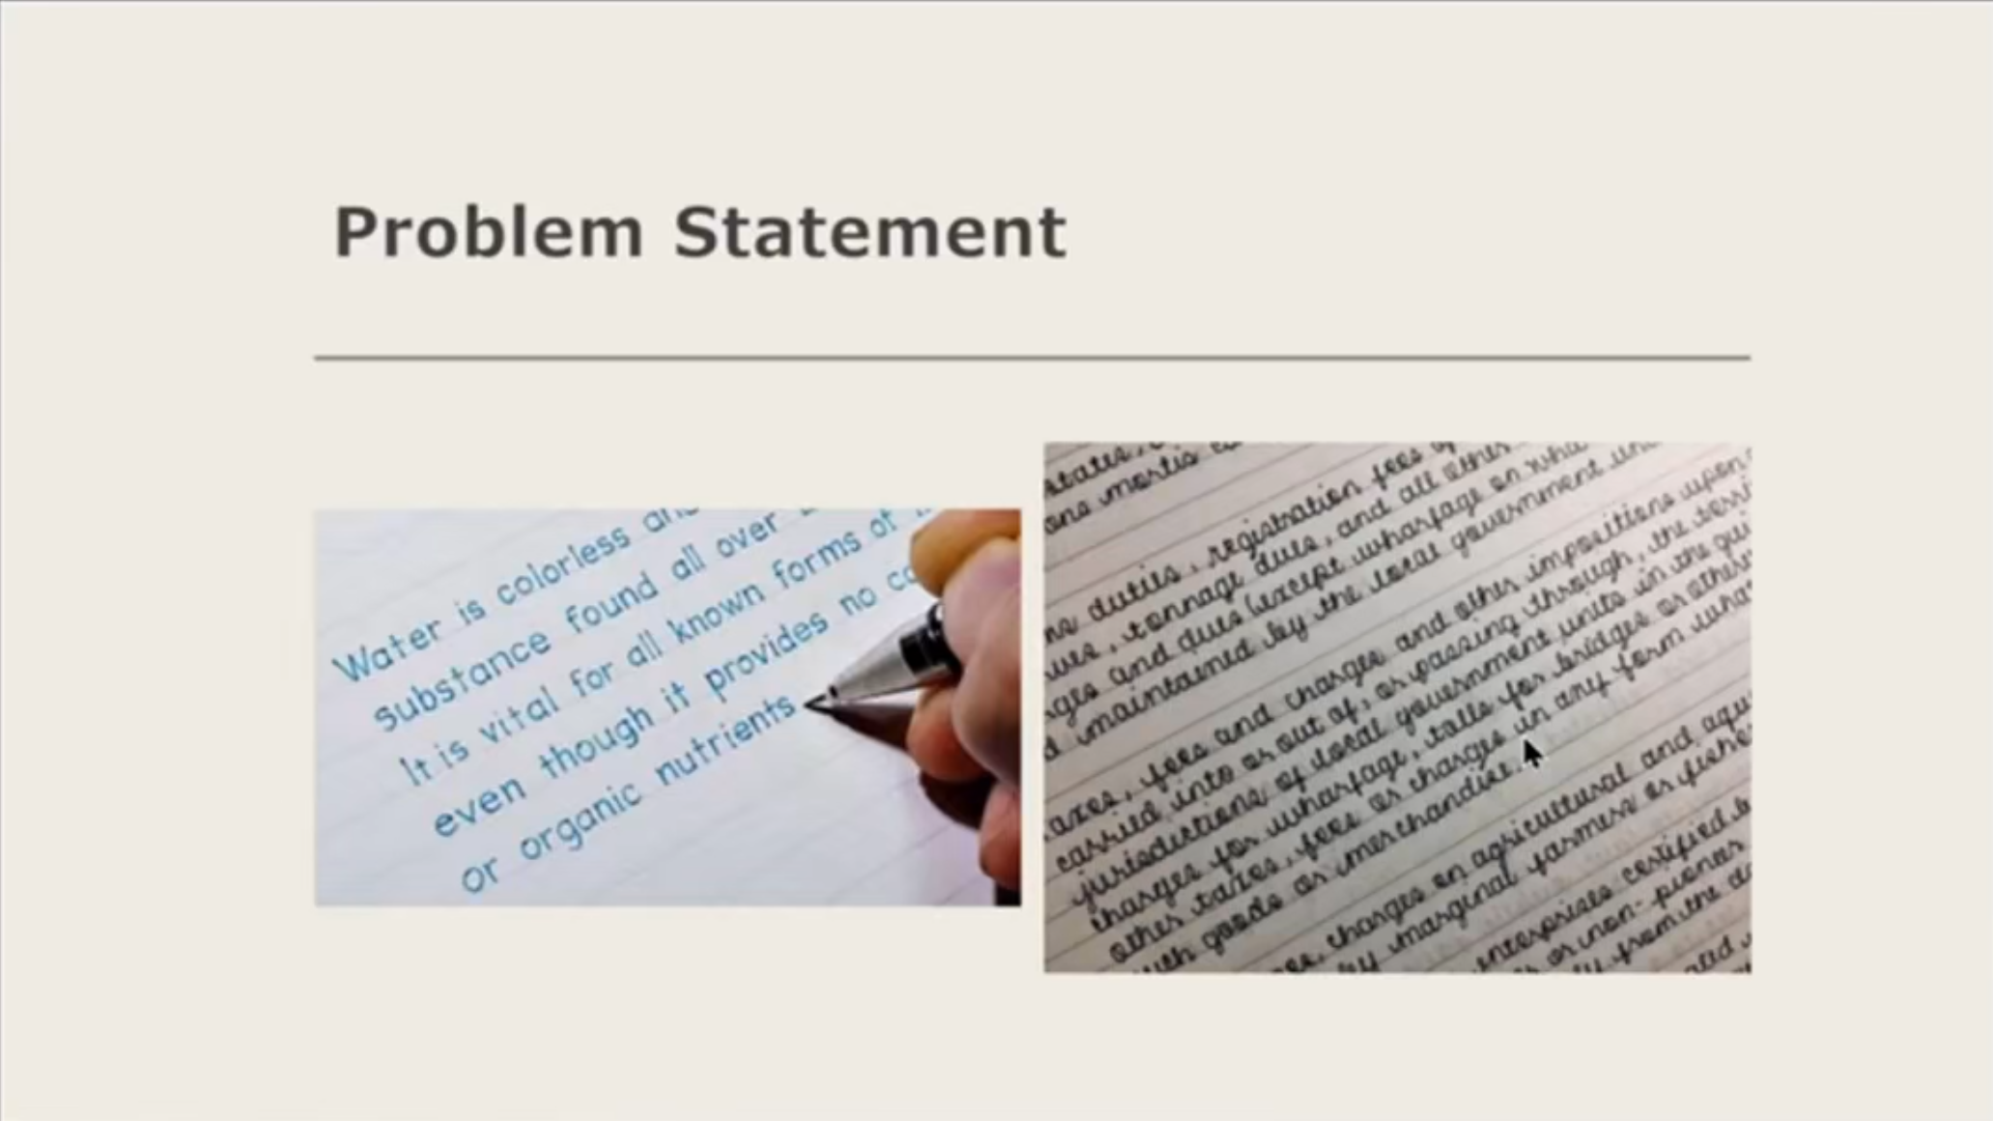
Notes:
Andoni first clearly defined the problem of inconsistency in handwritten digits and effectively explained the motivation for how computer vision and machine learning, especially neural networks, could be utilized to solve it. Although the nature of the input data was fundamentally different from my movie revenue prediction problem, his method of defining a real-world problem and motivating a technical solution was noteworthy.

Slide 4
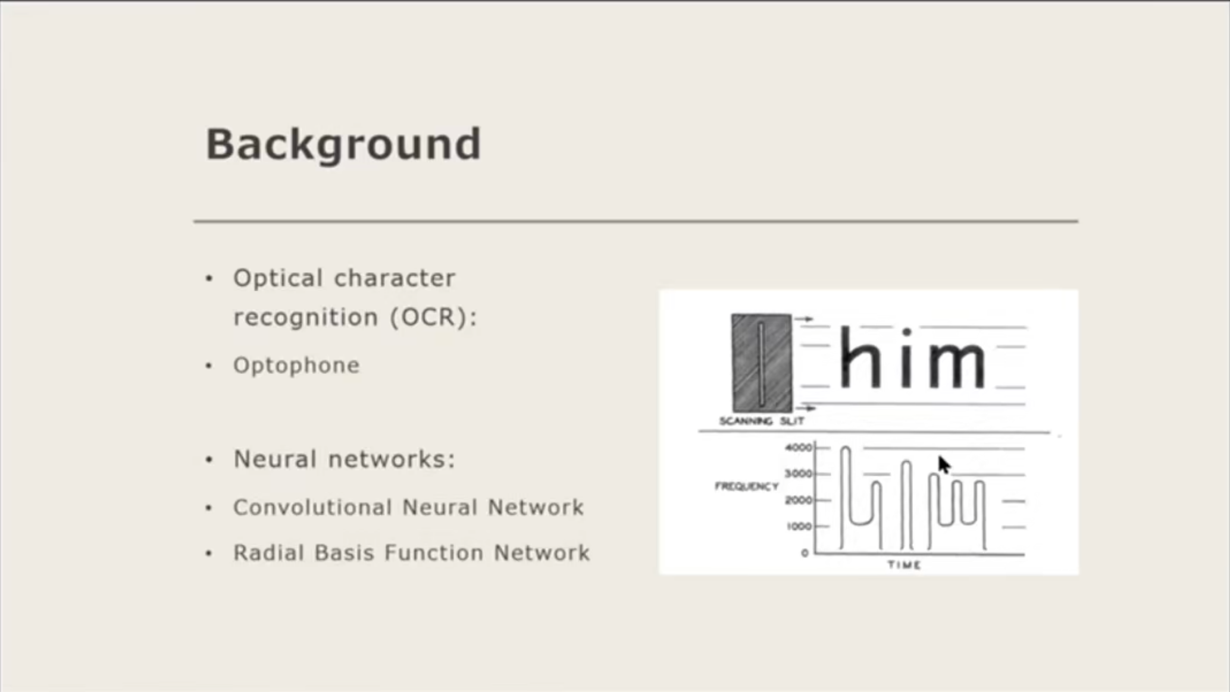
Notes:
He started with the history of OCR and briefly explained the background knowledge of various neural networks. He then clearly presented the characteristics of the well-known MNIST dataset. While I faced difficulties during the data cleaning process where my sample size significantly decreased, it seems Andoni was able to focus on model building in a stable environment using a relatively standardized and well-known dataset.

Slide 5
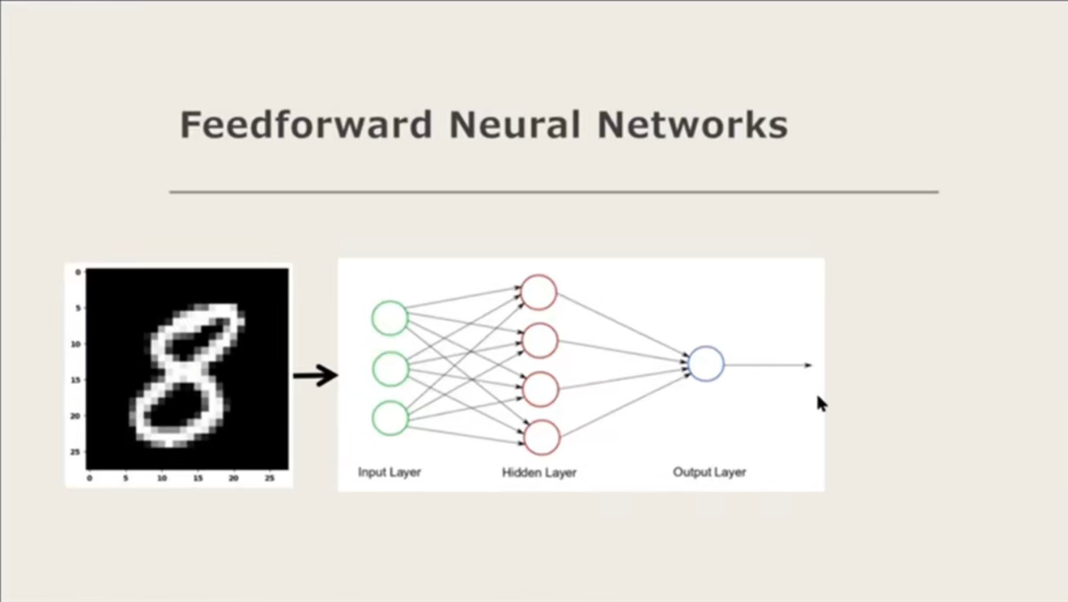
Notes:
In my presentation, due to time constraints, I had to focus mainly on the hyperparameter tuning results and omit many of these technical details. Andoni's presentation thoroughly covered this part, aiding the understanding of the model's working principles. I believe such detailed explanation was possible because he implemented it himself.

Slide 6
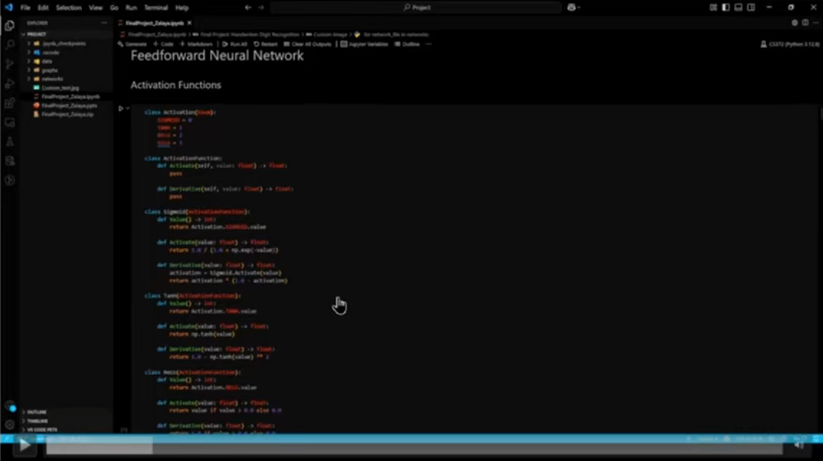
Notes:
In the demo part, he showed the code he implemented and explained how it actually worked. When showing the learning progress, Andoni plotted the accuracy change based on the batch index. I also considered batch size and the number of epochs as hyperparameters, but I spent a lot of time tuning the number of layers and neurons and couldn't cover this aspect. Andoni's results also showed a specific network momentarily stagnating early in training, seemingly trapped in a local minimum, which suggests the importance of trying various hyperparameter combinations.

Slide 7
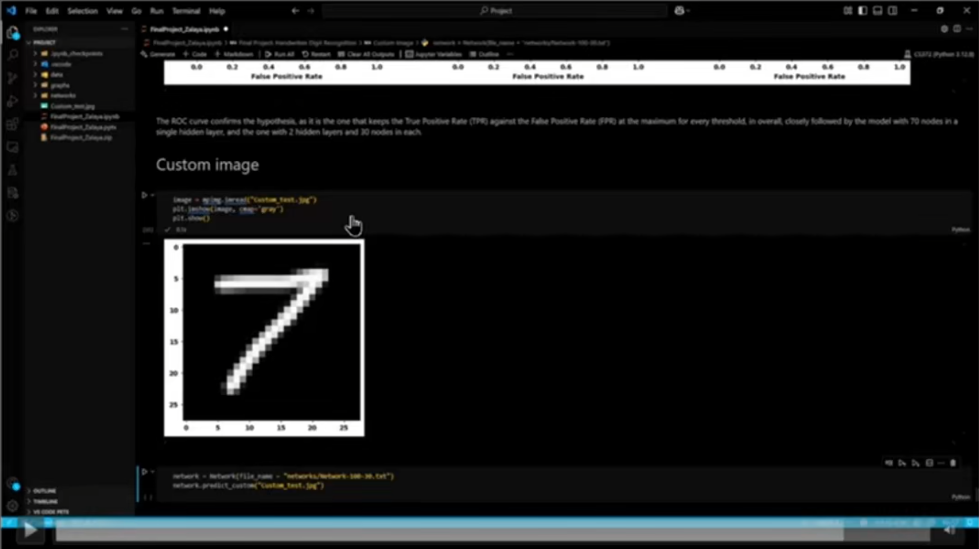
Notes:
In the results analysis section, it was good that he clearly showed the model's performance and problems across various network configurations using diverse visual materials such as confusion matrices, precision/recall/F1 scores, and ROC curves. Particularly, the part where he tested with a self-drawn digit '7' image and showed the model's limitation in mispredicting it as '2' or '1' provided an opportunity to think about the model's practical applicability and areas for improvement. Although he couldn't clearly identify the cause, speculating about potential issues in the data loading process allowed a glimpse into the problem-solving thought process.

Slide 8

Notes:
Through Andoni Zalaya's presentation, I confirmed that even with the same neural network technology, the approach and the depth of the presentation content can differ depending on the problem definition, data characteristics, and implementation method. I especially felt once again the deep understanding and explanatory power gained from implementing the model directly, the importance of tuning various hyperparameters, and the value of analyzing results through clear visualization. I learned that thoroughly covering technical details, like Andoni did, greatly helps in understanding the model.

Slide 9
Thank you
CS372/Minjae Kyung
Notes:
Thank you for watching

